Slide 1

Vel Tech Rangarajan Dr. Sagunthala R&D Institute of Science and Technology
School of Computing
Department of Computer Science and Engineering
10211CS224 / FULL STACK APPLICATION DEVELOPMENT
PROJECT REVIEW : MILESTONE PROJECT – 2
Date: 06-05-2026
React JS based Web application for Ticket Booking
SDG: 9 – Sustainable Development Goal
Presented By:
K. Gowtham Sai – VTU25540 – 23UECS0254
Courses Handling Faculty:
Dr. S . HEMAMALINI – M.E., Ph.D.,

Slide 2
INTRODUCTION
Background of the problem:
Manual ticket booking systems lack automation and real-time seat management.
Why this project is important:
It simplifies ticket booking and provides instant confirmation with reduced errors.
Real-world relevance:
Useful for managing departmental events like technical fests, seminars, and workshops.
Brief overview of the system:
Useful for managing departmental events like technical fests, seminars, and workshops
1
2
3
4
5
6
7
8
9

Slide 3
PROBLEM STATEMENT
In many educational institutions and organizations, ticket booking for internal events such as technical fests, seminars, and workshops is often handled manually or through basic systems that lack proper automation. This creates difficulties in managing participants, tracking ticket availability, and ensuring smooth registration. Manual processes can lead to overbooking, data errors, and delays in confirmation. Additionally, there is no centralized system to monitor bookings and generate reports efficiently. Therefore, there is a need for a secure, reliable, and fully automated ticket booking system that allows users to book tickets easily, provides real-time updates, and enables administrators to manage events effectively. Such a system improves accuracy, saves time, and enhances the overall event management experience.
1
2
3
4
5
6
7
8
9

Slide 4
OBJECTIVES
1
2
3
To Design and develop a React JS-based web application for efficient event ticket booking.
To provide real-time ticket availability and instant booking confirmation.
To develop an admin panel for managing events, bookings, and users.
To develop an admin panel for managing events, bookings, and users.
4
5
6
7
8
9

Slide 5
PROPOSED SYSTEM
1.The proposed system is a React JS-based web application for managing event ticket booking in a single platform.
2. It allows users to register, view events, and book tickets.
3. Admin can create and manage events.
4. It provides real-time ticket availability and instant booking confirmation.
5. The system stores booking details securely and generates reports.
6. It reduces manual work and saves time.
7. It avoids mistakes in Money calculation.
8. It is faster and more efficient than manual systems.
1
2
3
4
5
6
7
8
9

Slide 6
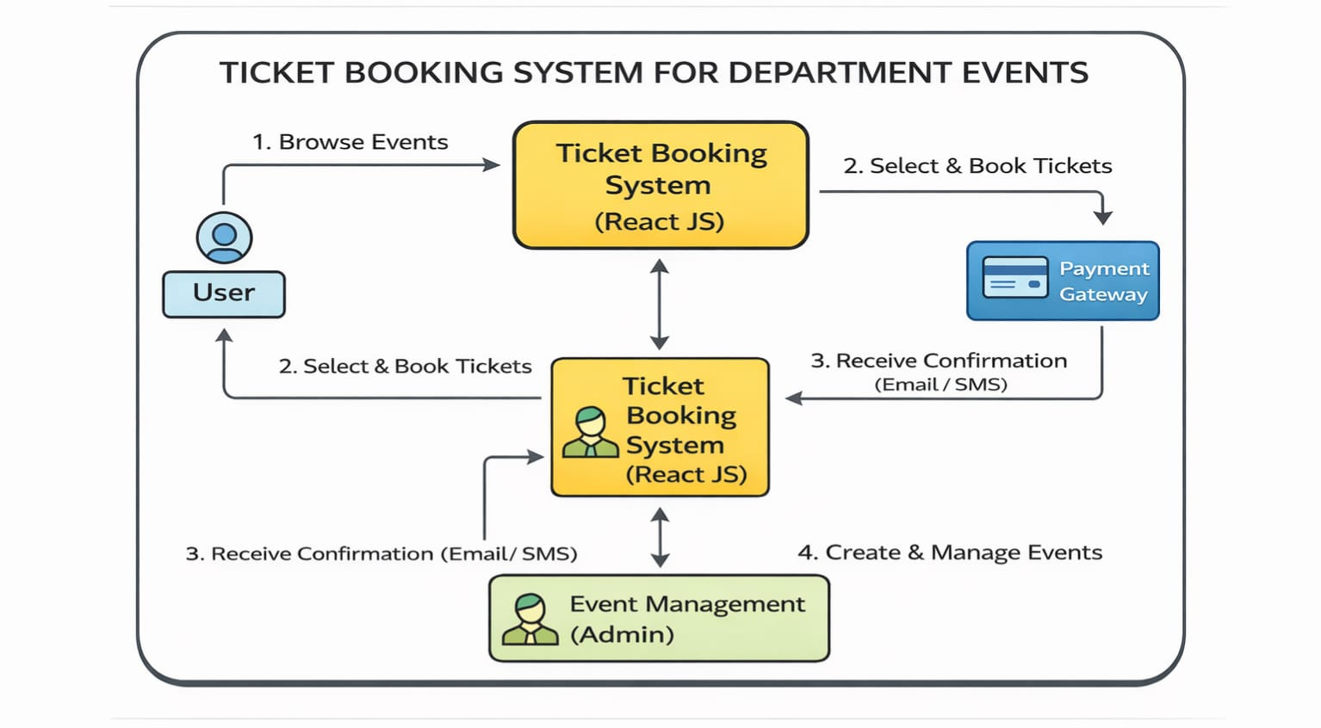
PROPOSED SYSTEM ARCHITECTURE
1
2
3
4
5
6
7
8
9

Slide 7
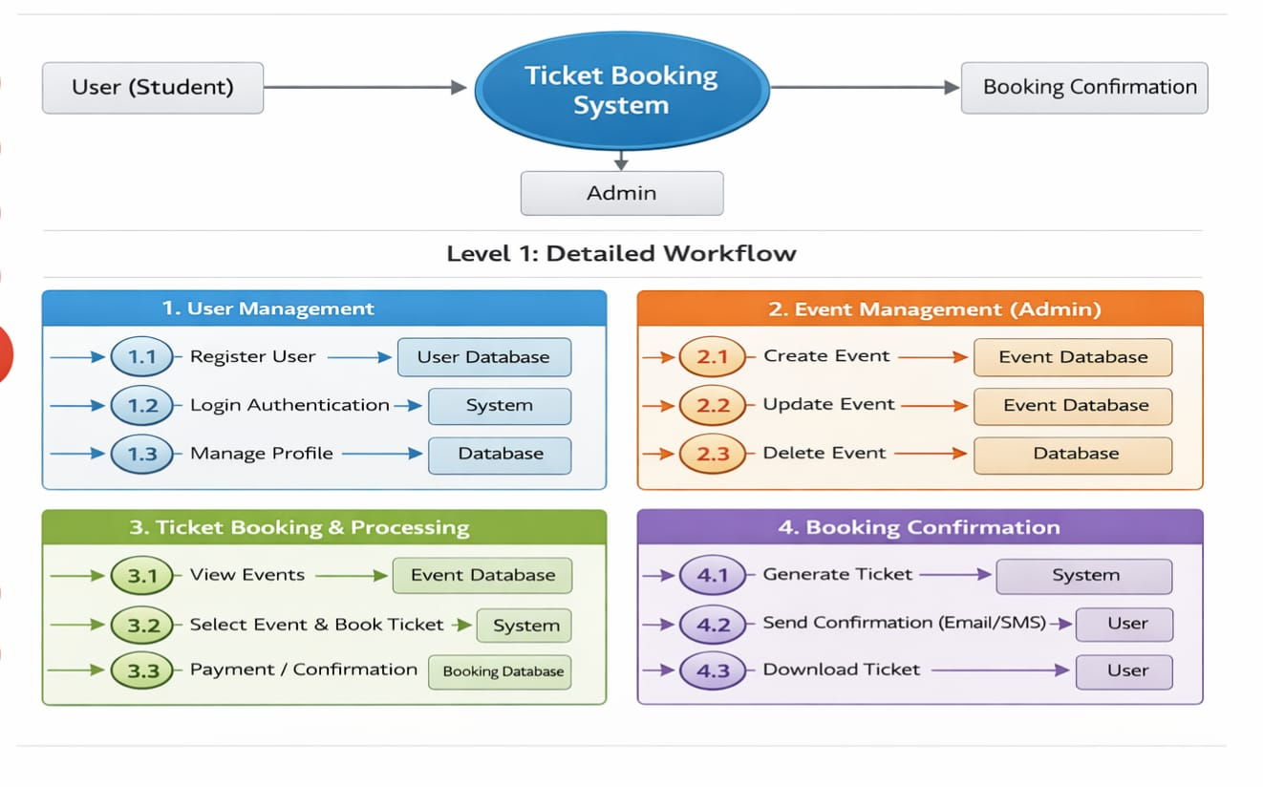
WORKFLOW
1
2
3
4
5
6
7
8
9

Slide 8
TECHNOLOGIES USED
Frontend:
1.HTML5
2.CSS3
3.Javascript
4.React JS
Backend:
1.Node JS
2.java
Data Base / Tools:
1.Mysql
Software Requirements:
1.Windows / Mac
2. Web Browser
1
2
3
4
5
6
7
8
9

Slide 9
MODULE DESCRIPTION
Module 1: User Management
Handles user registration, login, and profile management with secure authentication.
Module 2: Quiz Management
Allows admin to create, update, and delete events and manage event details.
Module 3: Ticket Booking
Enables users to view events, select tickets, and complete the booking process.
Module 4: Booking Confirmation
Generates booking confirmation and allows users to download or receive tickets.
1
2
3
4
5
6
7
8
9

Slide 10
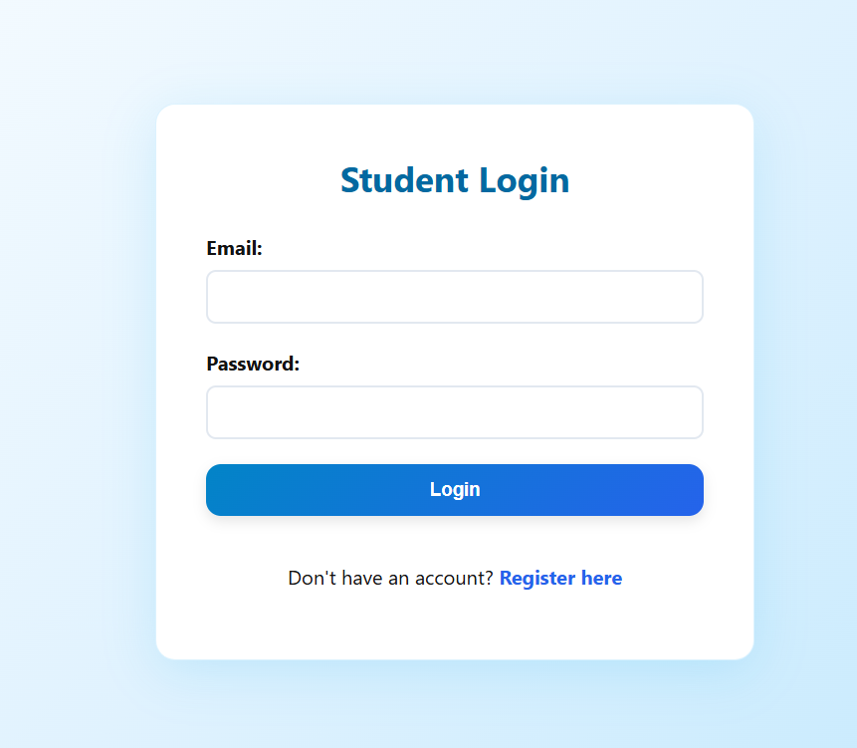
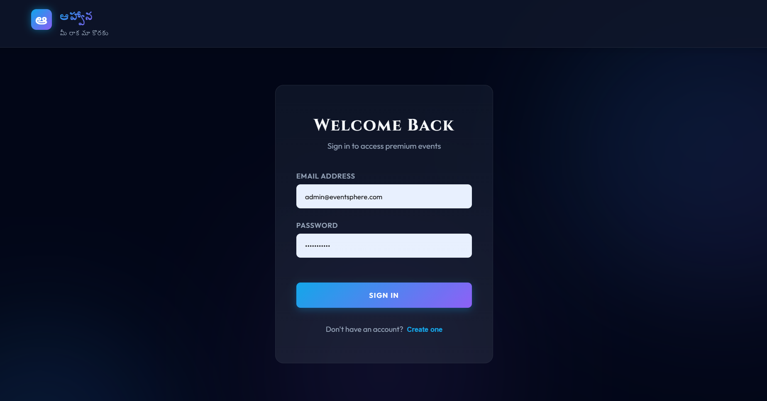
IMPLEMENTATION SCREENSHOTS
1
2
3
4
5
6
7
8
9

Slide 11
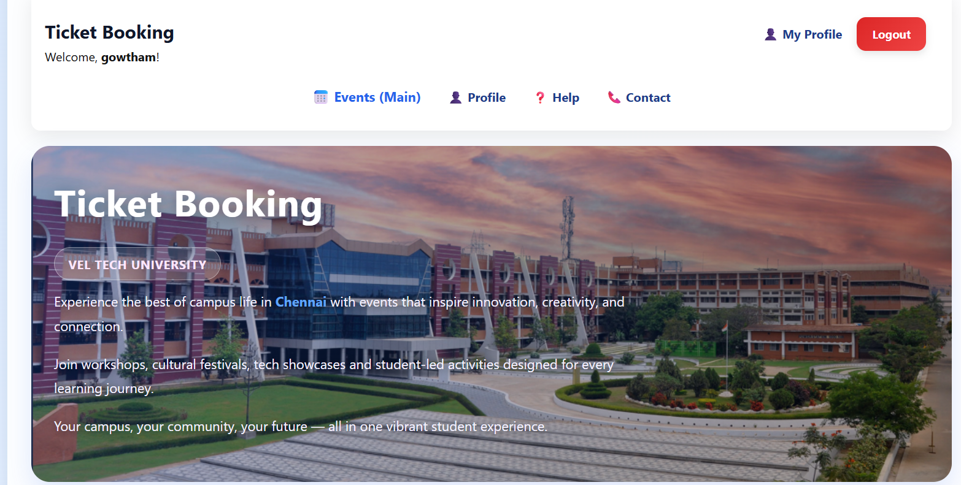
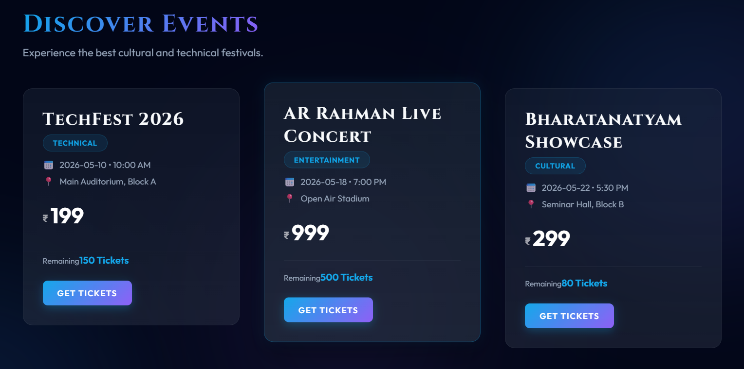
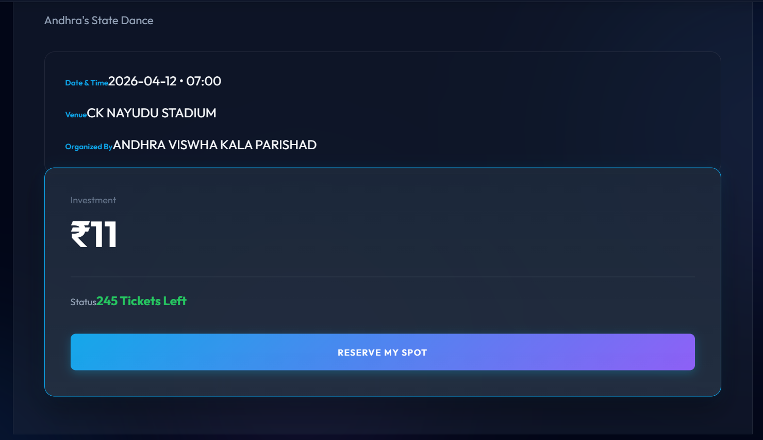
IMPLEMENTATION SCREENSHOTS
1
2
3
4
5
6
7
8
9

Slide 12
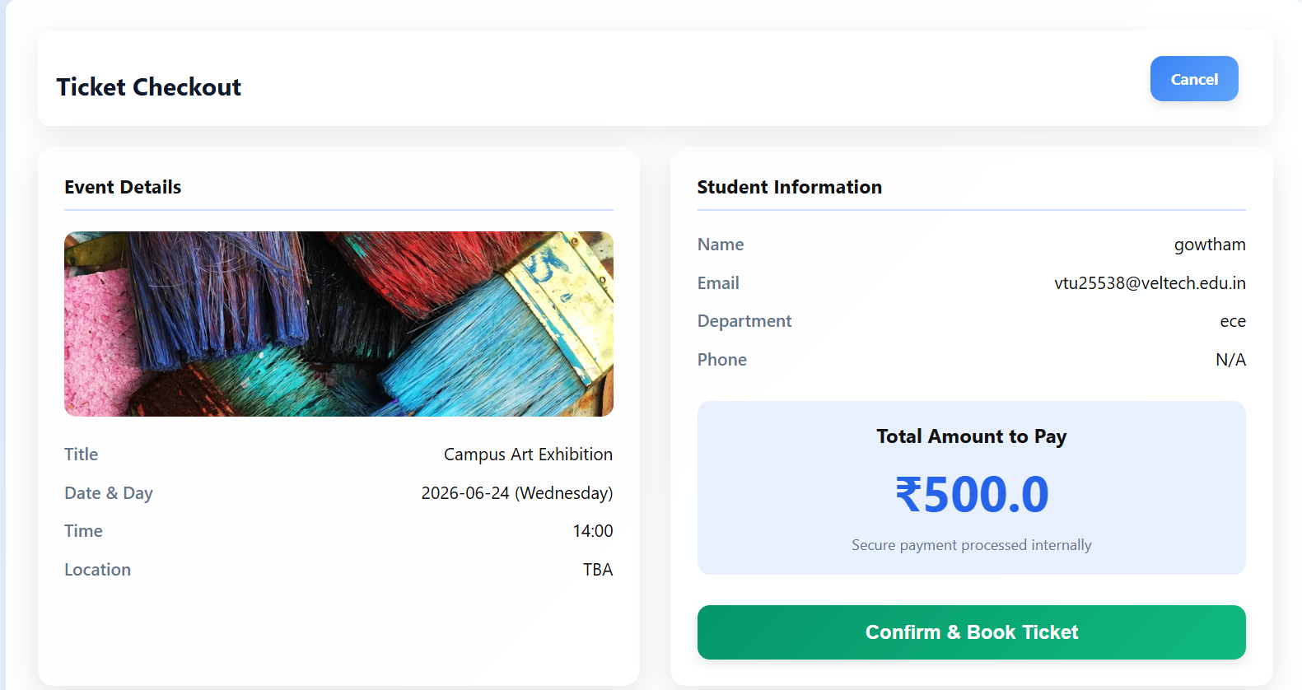
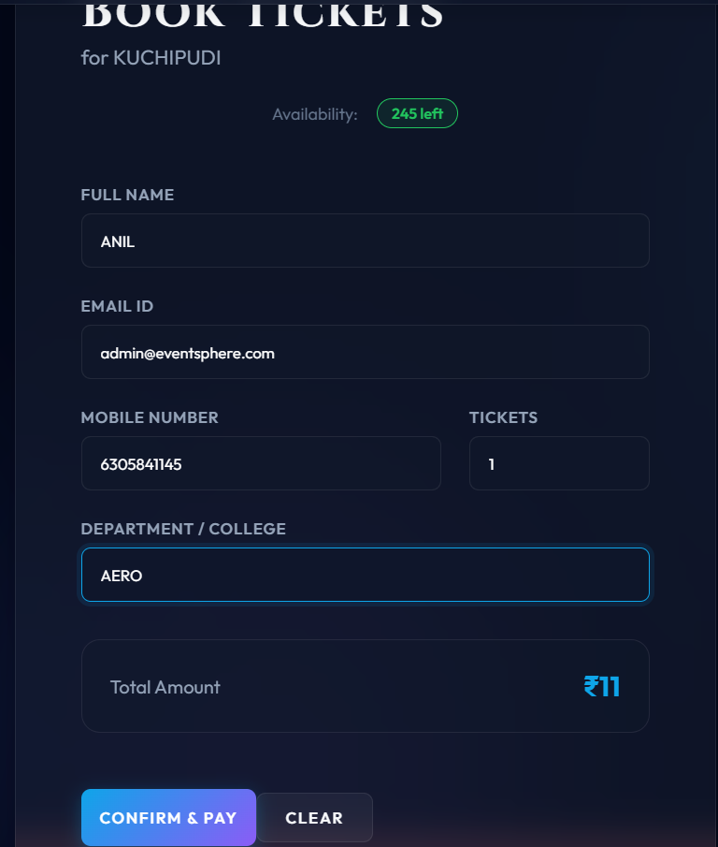
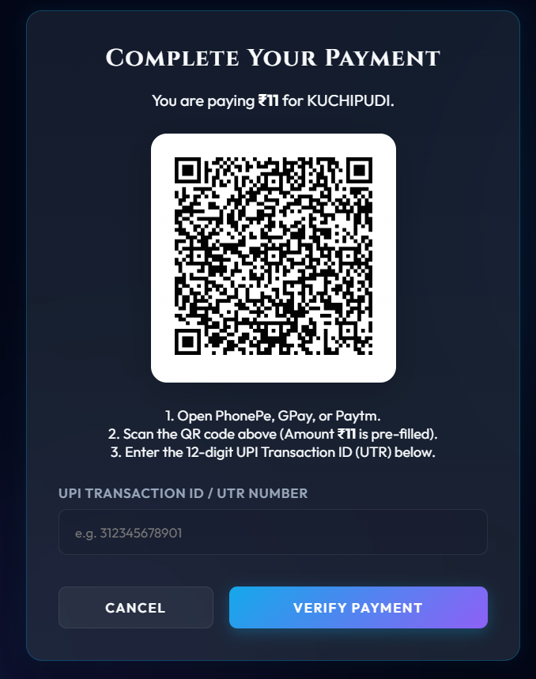
IMPLEMENTATION SCREENSHOTS
1
2
3
4
5
6
7
8(B)
9

Slide 13
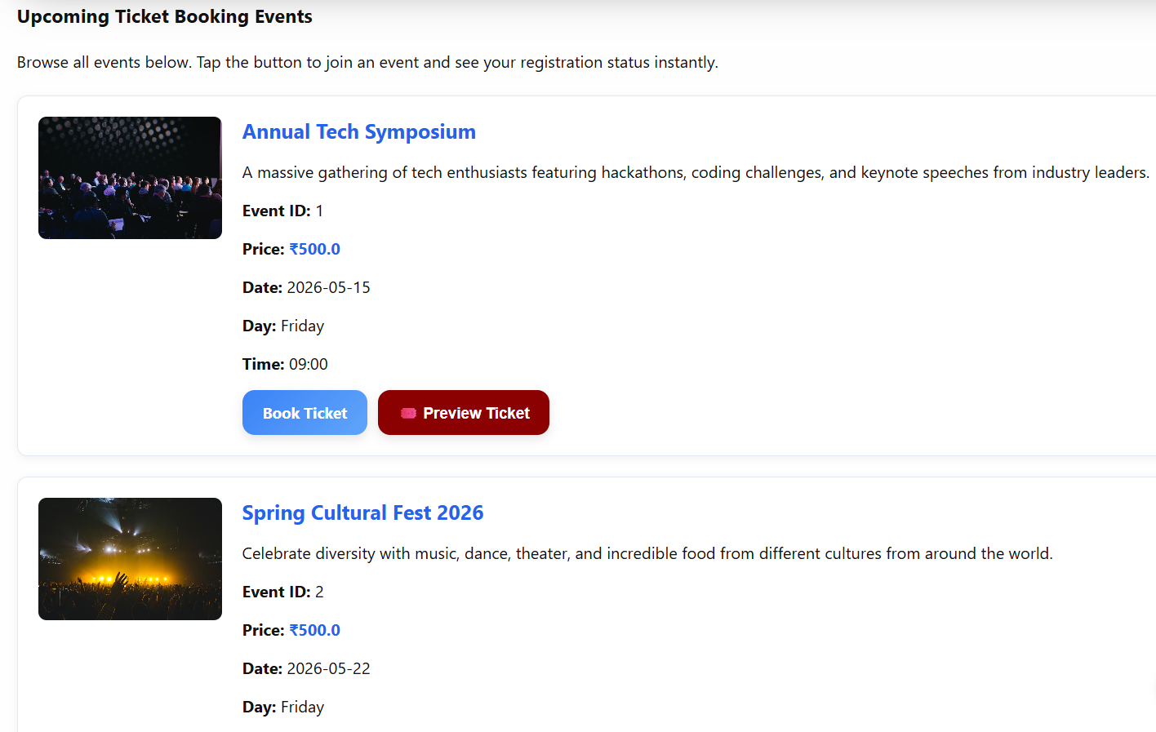
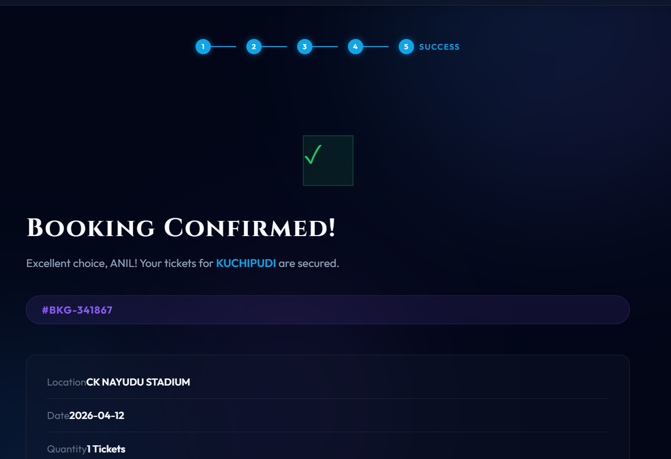
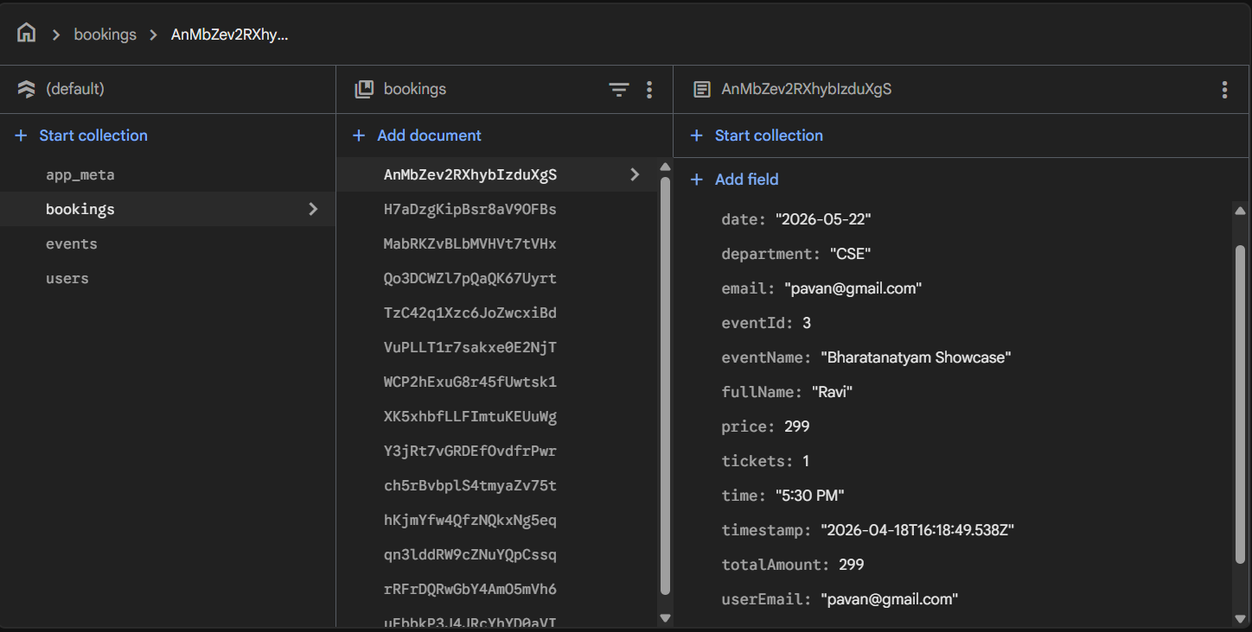
IMPLEMENTATION SCREENSHOTS
1
2
3
4
5
6
7
8(C)
9

Slide 14
ADVANTAGES & LIMITATIONS
Advantages:
1.Time saving and Fully Automated.
2. Real-time ticket availability and instant confirmation.
3. Easy access and user-friendly interface.
Limitations:
1. Initial setup and development complexity.
2.Internet Dependency(Stable Internet connection is Required).
3.Security and Malpractice Issues.
4. Depends on system/server availability.
1
2
3
4
5
6
7
8
9

Slide 15
Thank you

